Slide 1


GSI
GLObal
solutıons
Istanbul

Slide 2
Gsı under gıs
GIS
GSMC
GADC
GISS
Istanbul (GSI)
Bangalore
Dalian

Slide 3
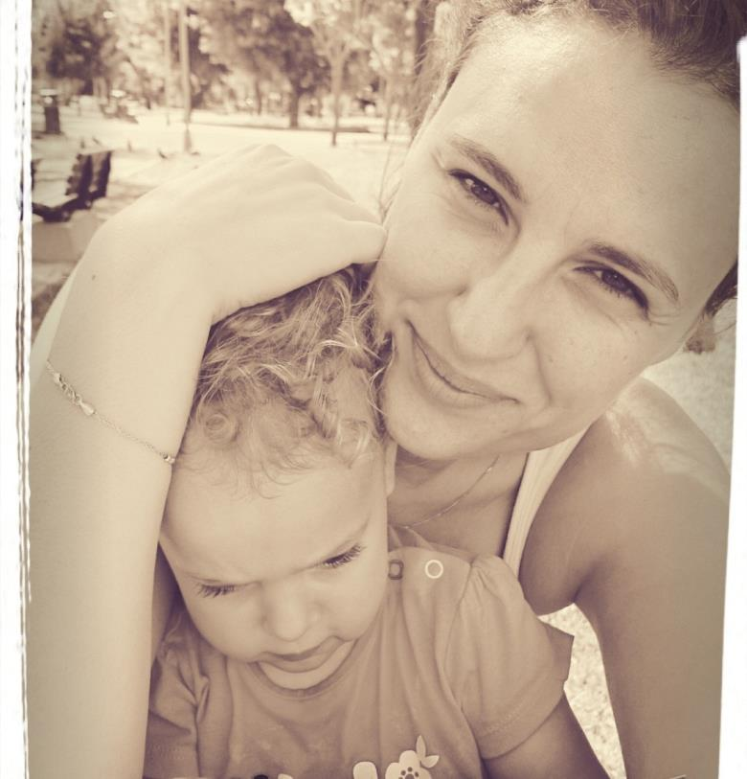
2003
Specialist Analyst ProGrammer
at Yapi Kredi Bank
2006
2007
Senior Developer
at HSBC Bank
2008
sony - Java Developer
at ODW & Sony1
2009
At MCR Project
2010
At Relaunch Project
2011
At Stock & Sales Project
Pinar cankaya
2012
Applıcatıon delıvery manager
Ebase / sony1 / spıder
2013
At GPW Project
2014
Applıcatıon delıvery Manager
to Odw / eBase
2015

Slide 4
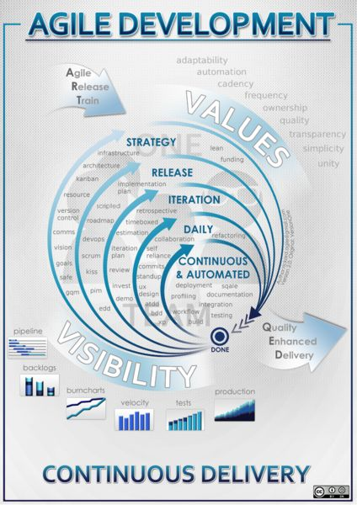
AGILE soFTWARE development
An iterative and incremental approach to software development
performed in a highly collaborative manner
by self-organizing teams
with "just enough" ceremony
that produces high quality software
in a cost effective and timely manner
which meets the changing needs of its stakeholders

Slide 5
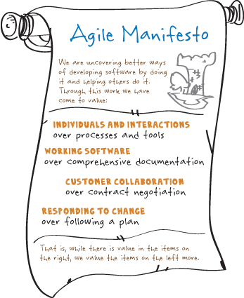
Notes:
There are 4 values in manifesto :
İt says that in agile methodology :
– Individuals and interactions over processes and tools – Working software over comprehensive documentation – Customer collaboration over contract negotiation – Responding to change over following a plan

Slide 6
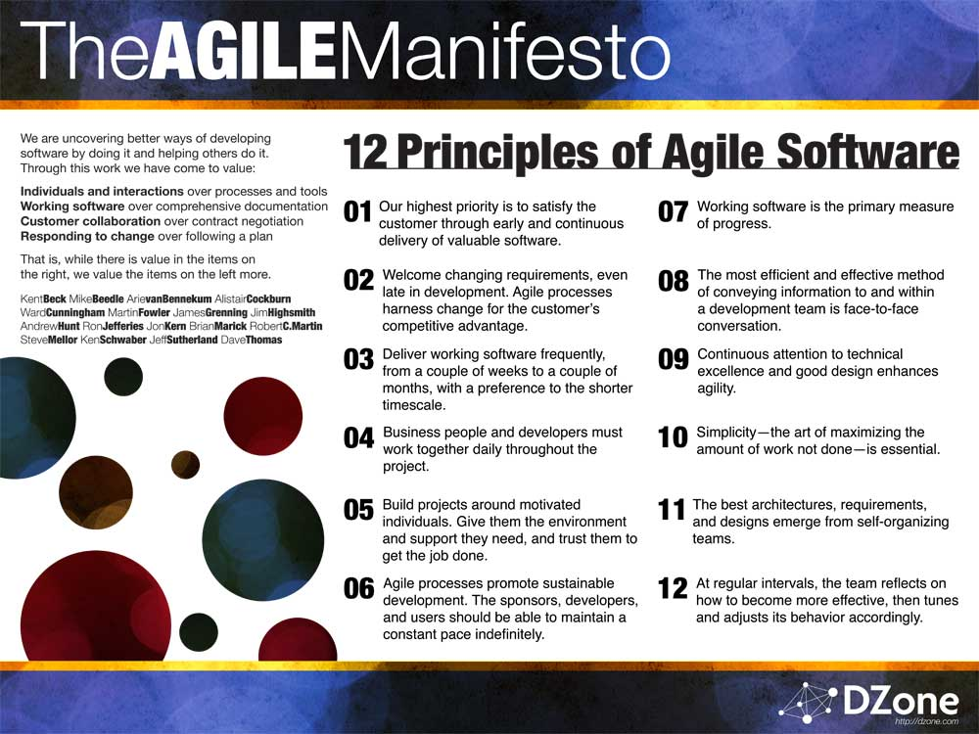
Notes:
As a
1. Our highest priority is to satisfy the customer through early and continuous delivery of valuable software. 2. Welcome changing requirements, even late in development. Agile processes harness change for the customer’ competitive advantage. 3. Deliver working software frequently, from a couple of weeks to a couple of months, with a preference to the shorter timescale. 4. Business people and developers must work together daily throughout the project. 5. Build projects around motivated individuals. Give them the environment and support they need, and trust them to get the job done. 6. The most efficient and effective method of conveying information to and within a development team is face-to-face conversation. 7. Working software is the primary measure of progress. 8. Agile processes promote sustainable development. The sponsors, developers, and users should be able to maintain a constant pace indefinitely. 9. Continuous attention to technical excellence and good design enhances agility. 10. Simplicity–the art of maximizing the amount of work not done–is essential. 11. The best architectures, requirements, and designs emerge from self-organizing teams. 12. At regular intervals, the team reflects on how to become more effective, then tunes and adjusts its behavior accordingly. not sure about visuals

Slide 7
practices of AGILE
Agile development is supported by a bundle of concrete practices suggested by the agile methods, covering areas like requirements, design, modeling, coding, testing, project management, process, quality, etc.
Some notable agile practices include:
Backlogs (Product and Sprint)
Cross-functional team
Continuous integration (CI)
Information radiators (Scrum board, task board, burndown chart)
Iterative and incremental development (IID)
Pair programming
Planning poker
Refactoring
Scrum meetings (Sprint planning, daily scrum, sprint review and retrospective)
Test-drıven development (tdd)
Agıle testıng
User story
Retrospectıve
Velocıty trackıng

Slide 8
AGILE frameworks
Well-known agile software development methods and/or process frameworks include:
Adaptive software development (ASD)
Agile modeling
Agile Unified Process (AUP)
Crystal Clear Methods (Crystal Clear)
Disciplined agile delivery
Dynamic systems development method (DSDM)
Extreme programming (XP)
Feature-driven development (FDD)
Lean software development
Kanban (development)
Scrum
Scrum ban

Slide 9
SCRUM as an AGILE METHOD
Scrum in 100 words
Scrum is an agile process that allows us to focus on delivering the highest business value in the shortest time.
It allows us to rapidly and repeatedly inspect actual working software (every two weeks to one month).
The business sets the priorities. Our teams self-manage to determine the best way to deliver the highest priority features.
Every two weeks to a month anyone can see real working software and decide to release it as is or continue to enhance for another iteration.

Slide 10
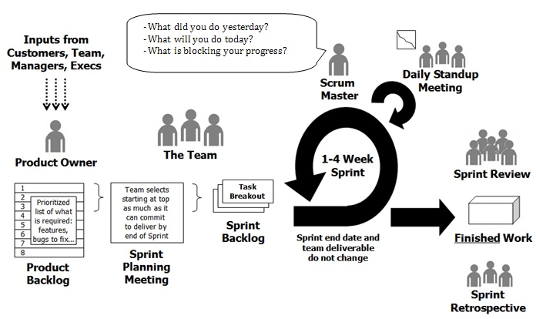
Scrum in a nutshell

Slide 11
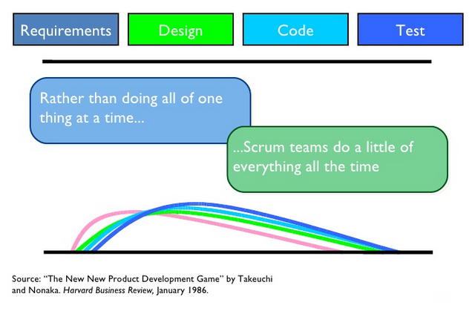
Sequential vs overlapping development

Slide 12
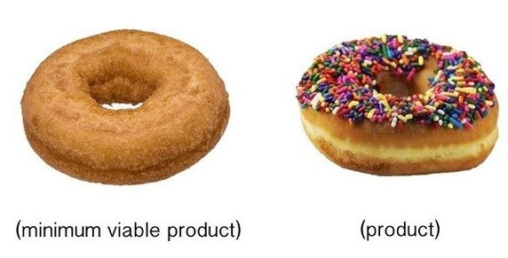
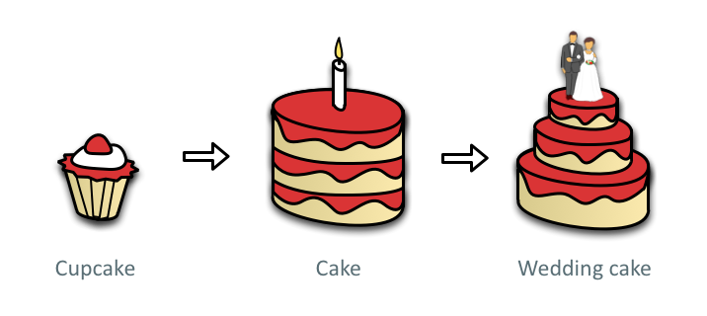
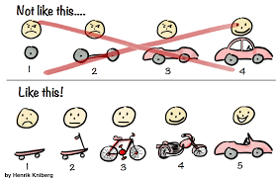
MVp mınımum vıable product
A Minimum Viable Product
is the smallest thing you can build that delivers customer value

Slide 13
Characteristics of scrum
Self-organizing teams
Product progresses in a series of month-long “sprints”
Requirements are captured as items in a list of “product backlog”
No specific engineering practices prescribed
Uses generative rules to create an agile environment for delivering projects
Iterative, incremental process
developing systems/ products with rapidly changing requirements
Improve communication and maximize cooperation
Protecting the team form disruptions and impediments
A way to maximize productivity
Notes:
SCRUM is an agile, lightweight process for managing and controlling software and product development in rapidly changing environments.

Slide 14
Scrum framework
Roles
Ceremonies
Artifacts
Product owner
Sprint planning
Product backlog
SCRUm master
Team
Sprint review
Sprint retrospective
Daily scrum meeting
Sprint backlog
Burndown chart

Slide 15

Roles
picture by exfordy

Slide 16
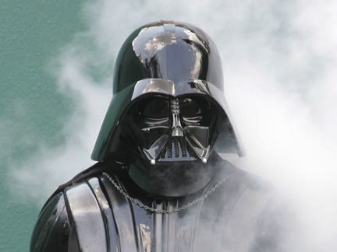
Product Owner
Owner of project vision
Represents the customer
picture by Official Star Wars Blog

Slide 17
Product Owner
Define features (according to vision)
Prioritize features (according to ROI)
Pick release dates
Give feedback
Manage stakeholders
Accept or reject results

Slide 18
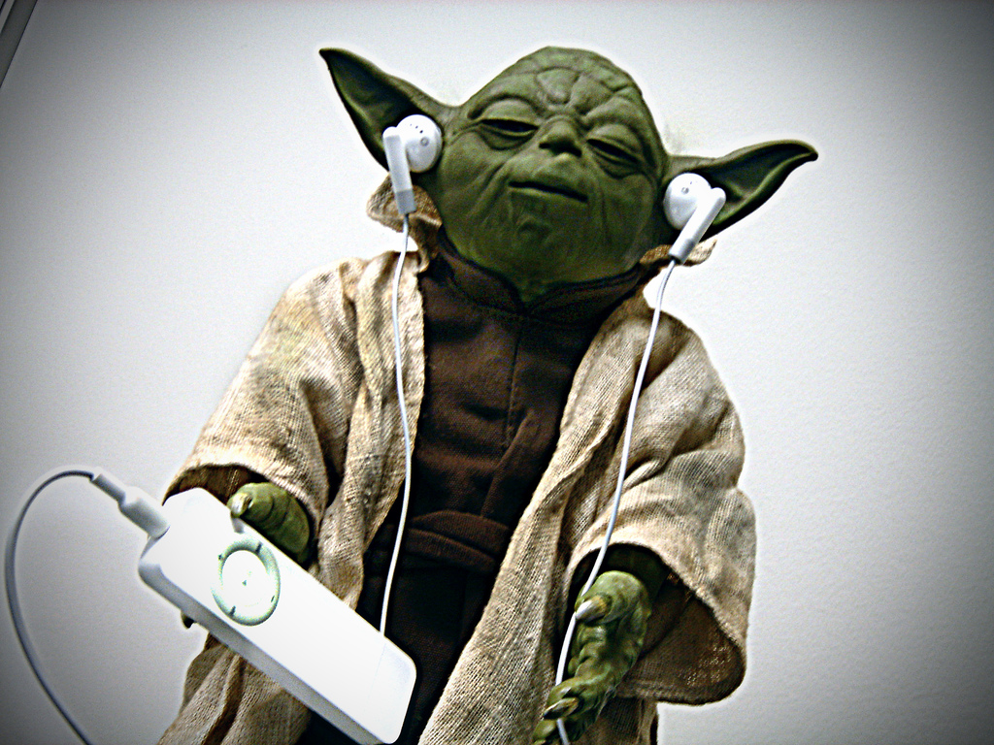
Scrum Master
Servant leader
Team protector
Troubleshooter
Scrum guide
picture by Orange Beard

Slide 19
Scrum Master
Remove impediments
Prevent interruptions
Facilitate the team
Support the process
Manage management

Slide 20

The Team
Self-motıvated Small (5–9 people)
Collocated Cross-functional
Self-organized Full-time
picture by ewen and donabel

Slide 21
The Team
Define tasks
Estimate effort
Develop product
Ensure quality
Evolve processes

Slide 22
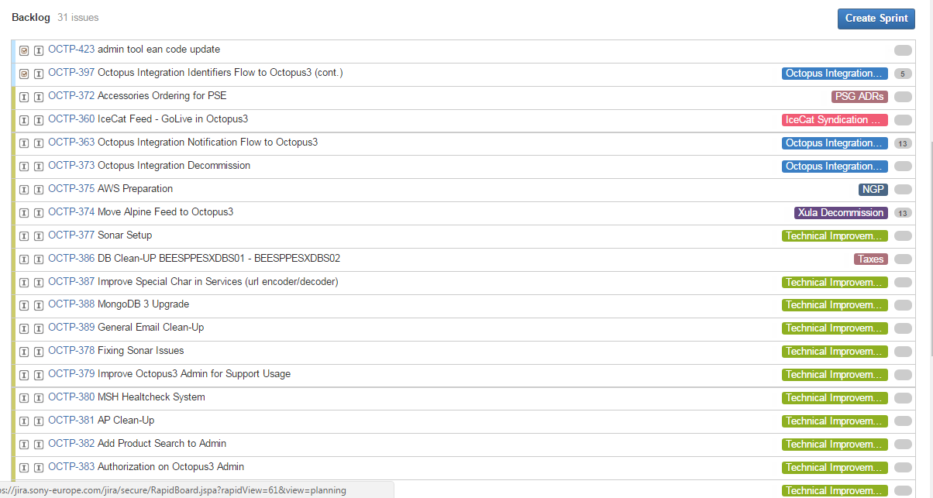
Product Backlog

Slide 23
Product Backlog
Owned by Product Owner
High-level requirements
Expressed as business value
Not complete, nor perfect
Expected to change & evolve

Slide 24
User Stories
Feature description
Have “conditions of satisfaction” (acceptance criteria) which can be tested in review
Have no/minimal dependency on other stories
As a <user> I want <functionality>
so that <benefit/conditions of satisfaction>
**
As the DAS Business owner, I want to integrate with Amazon Spain for product images, So that I can syndicate the images to amazon.es site.

Slide 25
Types of stories
A typical Scrum backlog comprises the following different types of items :
Features
Bugs
Tecnıcal ımprovements (refactorıng, versıon upgrades)
Taxes (onboardings, releases, trainings)
Business taxes (business roll-outs)
Spikes (investigations, scoping)

Slide 26

Acceptance criteria
A checklist which defines acceptance for a particular story
Defines business oriented tests that let us know if the implementation meets Product owner expectations

Slide 27

Acceptance criteria
User story :
As the PSE team, I want to have the classification engine for professional camcorders, So that I can use the engine to create selector pages.
Acceptance Criteria : * Finalize the implementation according analysis document * Implement the functional tests * Create the sample DSL file and provide to Prosony team
In review meeting;
* Show code * Show functıonalıty * Show functional test results * Show the DSL file

Slide 28
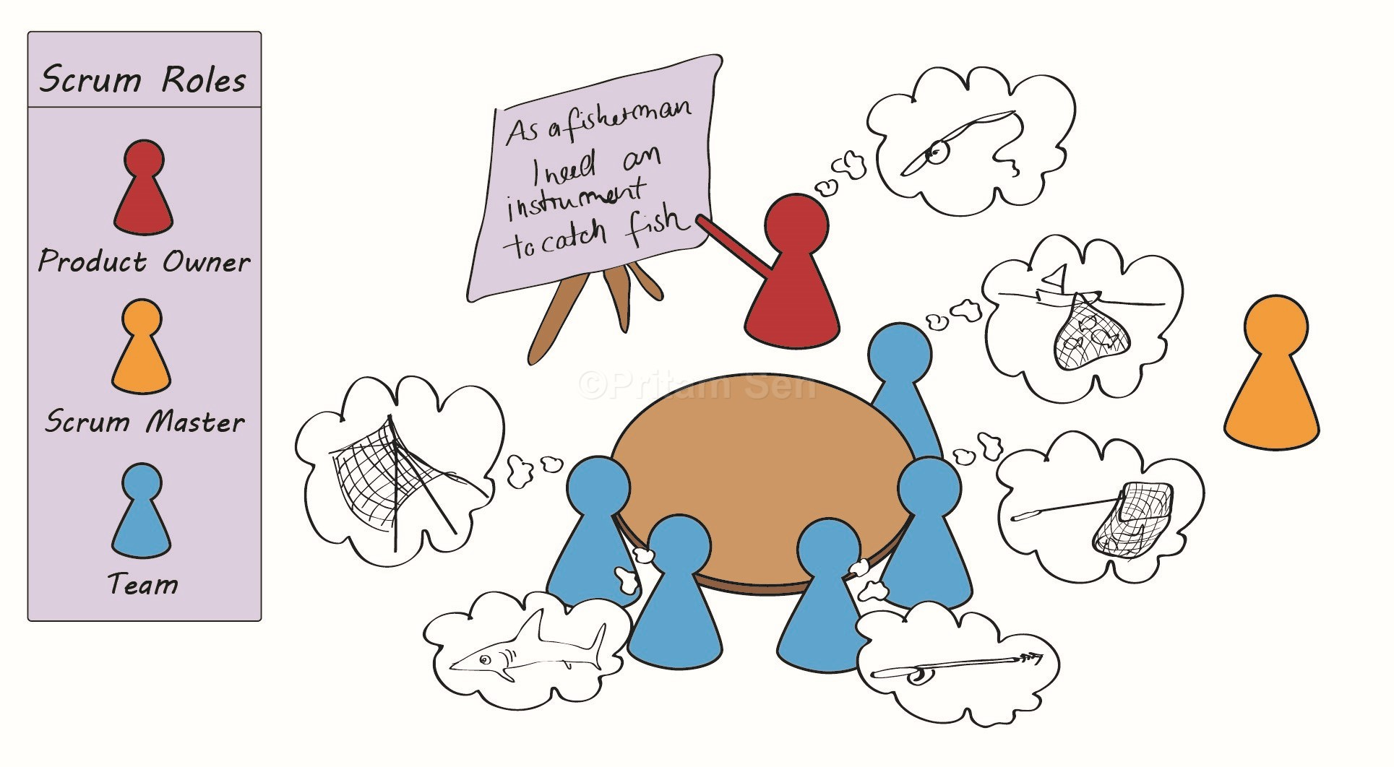
Product Backlog refinement
(grooming)

Slide 29
Product Backlog refinement
a meeting done during the sprint period to make sure the product backlog is prepared and ready for the start of the next sprint.
Provides Input for prioritization
Clarity of requirements
Dependencies
Assumptions
Acceptance criteria
High-level estimates

Slide 30
Product Backlog refinement
Agenda
PO introduces new/open epics/stories to the team
Team asks questions to learn more about the request
If all clear (team feels confident) team give estimations
If not story is parked and PO makes some investigations to be discussed in next grooming meeting
Facilitator PO
Duration Every week 1 hr/twice a week 1/2 hrs
Attendees PO and All team

Slide 31
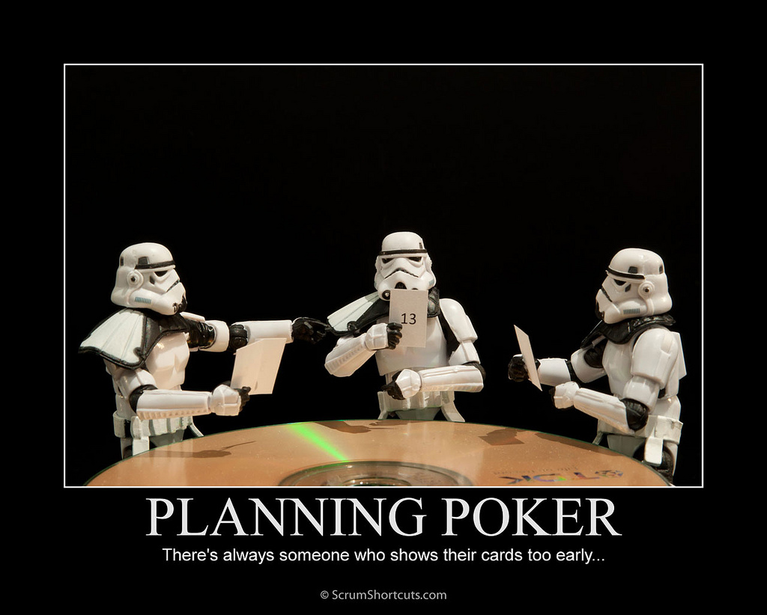

Slide 32
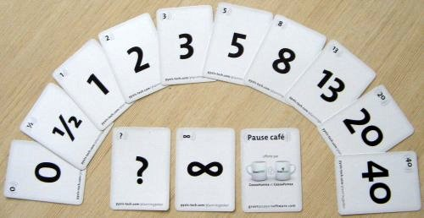
PLanning poker
All team members have a set of cards
PO presents story
If team is confident they select and show cards
The variations explained why?
Steps 3-4 repeated a few times
Decide the estimation of the story (STORY POINT)
Move to the next backlog item

Slide 33
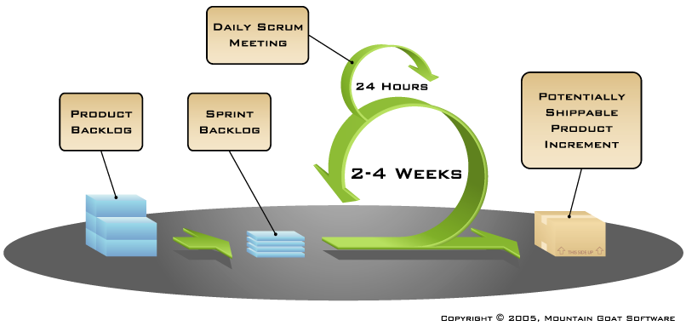
Sprints
Timeboxed – Frozen features
Variable scope – Shippable result

Slide 34
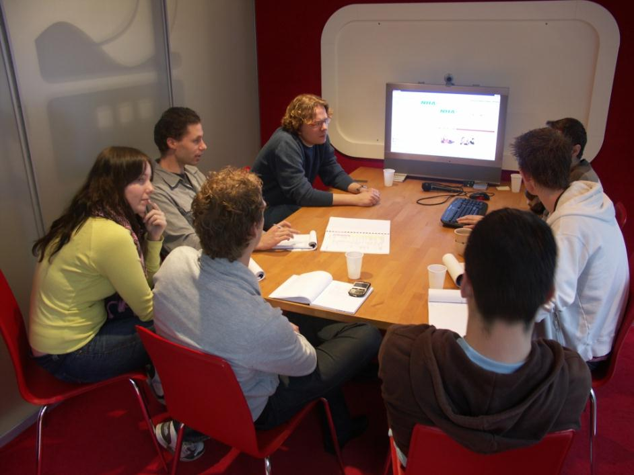
Sprint Planning
Prioritize/select storıes
Discuss acceptance criteria
Verify understanding
Use velocity (Yesterday’s Weather)
Share commitment
New Filter Implementation (1 hrs)
Update feed (5 hrs)
New Script for Crunchfish (8 hrs)
Octopedia wiki+ Release Notes (2 hrs)
DSL Integration (4 hrs)
TC (1 hrs)
MT (6 hrs)
As the DIME Business, I want to get only DIME products instead of getting all products in a separated feed, So that I can use this information in Mobile Application.

Slide 35
Sprint Planning
PO presents stories from product backlog
Sprint backlog is created
Team Defines sprint backlog items –tasks
Discuss acceptance criteria
Verify understanding
Team Estimates tasks collaboratively
High level design is considered
Team commits to the items that they can deliver
Use velocity (Yesterday’s Weather)

Slide 36
Team capacıty
Calculate :
How many days you have ın thıs sprınt : 9 day
How many members you have ın thıs sprınt : 5 members
Is there any vacatıon or somethıng else : 2 days vacatıon
Total capacıty ıs : 9 *5 – 2 = 43 md
Fınd your prevıous focus factor :
Focus factor : delıvered velocıty / team capacıty : 37 sp / 40 md = 0,92
Estımated velocıty :
Prevıus focus factor * new team capacıty = 0,92 * 43 md = 39,5 SP

Slide 37
Team capacıty detaıled
Calculate :
How many hours do you have ın a day : 8 hours
How many hours can you work : 5 hours
So Your drag factor : 3*100/8 = %37
How many developer hours ın thıs sprınt : 25 *5 = 125 hours
How many analyst hours ın thıs sprınt : 18 * 5 = 90 hours
You can use hour estımatıon :
To estımate what you can delıver more accurate
To calculate total developer/analyst tasks correctly

Slide 38
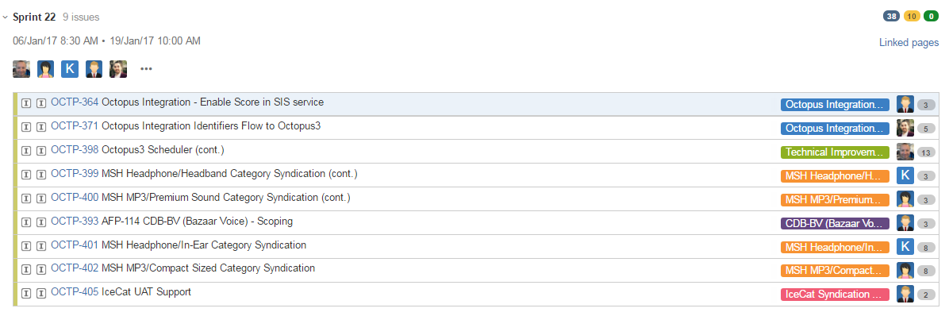
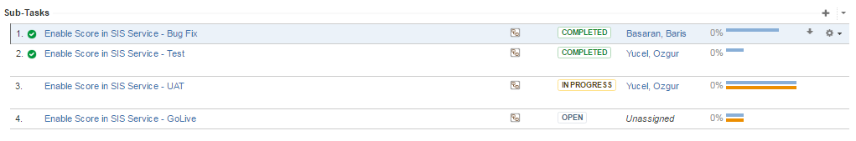
Sprint Backlog

Slide 39
In each sprınt try to :
ıncrease velocıty
Decrease drag factor

Slide 40
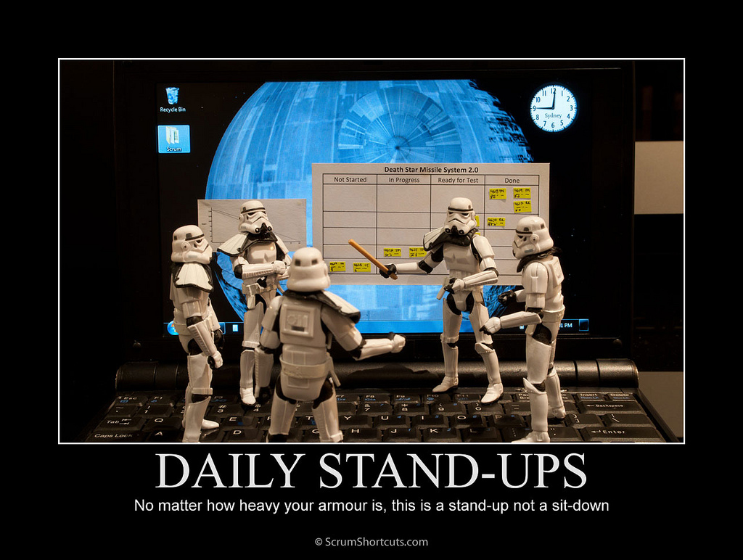
The heart beat of Scrum

Slide 41
Daily stand-ups
Commitment and accountability
Say what you do, do what you say
Whole world is invited
picture by Hamed Saber

Slide 42
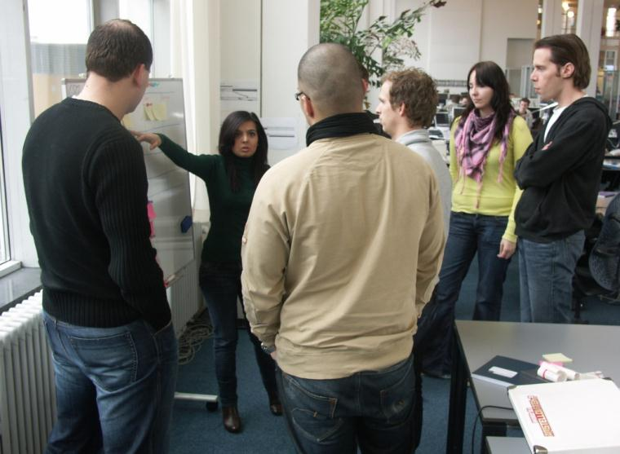
Daily stand-ups
What things are in my way
What I will do until next meeting
What I did since last meeting
Only the team talks
No problem solving
Max 15 minutes
Standing up

Slide 43
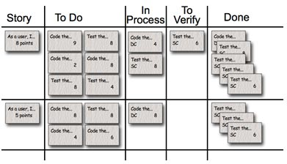
Task Board
Visibility
A general overview of the current iteration.
focal point for the daily meeting
Support full team commitment
Promotes team interaction and discussion
Good for new teams to visualize Scrum
Indications of bottlenecks or impediments.
Notes:
Promotes team interaction and discussion – Throughout the day you will see teammates, stakeholders and members of other teams stop by the board for discussion. This increases greatly if the board is located near the team and highly visible
Visibility – Anyone walking buy can make a quick second assessment on where the team is in the iteration. No cards left for a row? That story is complete. No white cards left, just green cards? Only testing remains. Lots of pink cards? Lots of defects.
Good for new teams to visualize Scrum – By having this tangible thing in front of them that they can touch, makes it easier for new Scrum teams to understand the process
Support full team commitment – Now the whole team sees all of the tasks daily and keeps them from just focusing on “their” tasks. When using task tracking tools it is too easy to just create a view of “my tasks” and then tune out the rest. Triggering flow amongst different roles in a team.

Slide 44
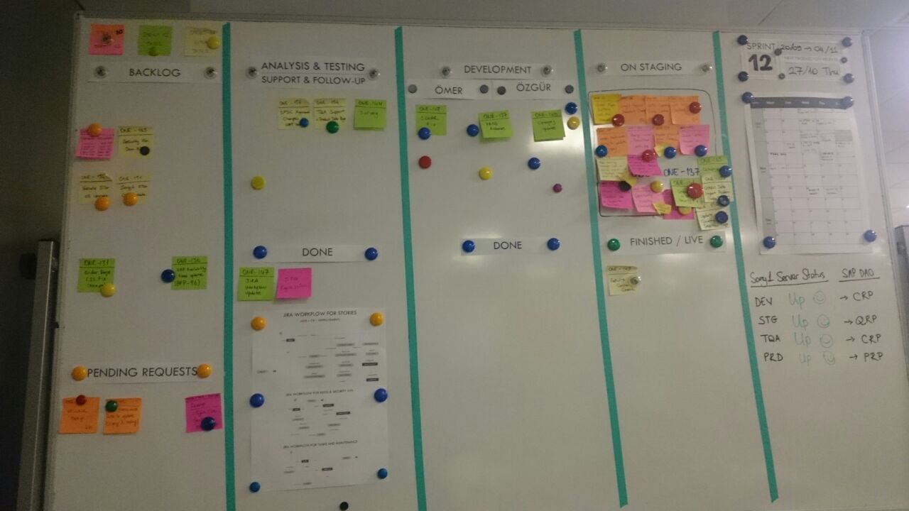
Task Board
picture by Mountain Goat Software
Notes:
Definition
In its most basic form, a task board can be drawn on a whiteboard or even a section of wall. Using electrical tape or a dry erase pen, the board is divided into three columns labeled "To Do", "In Progress" and "Done". Sticky notes or index cards, one for each task the team is working on, are placed in the columns reflecting the current status of the tasks.
Many variants exist. Different layouts can be used, for instance by rows instead of columns (although the latter is much more common). The number and headings of the columns can vary, further columns are often used for instance to represent an activity, such as "In Test".
The task board is updated frequently, most commonly during the daily meeting, based on the team's progress since the last update. The board is commonly "reset" at the beginning of each iteration to reflect the iteration plan.
When practicing Scrum, we can make the sprint backlog visible by putting it on a Scrum task board. Team members update the task board continuously throughout the sprint; if someone thinks of a new task (“Test the snark code on Windows 8.1”), she writes a new card and puts it on the wall. Either during or before the daily scrum, estimates are changed (up or down), and cards are moved around the board.

Slide 45
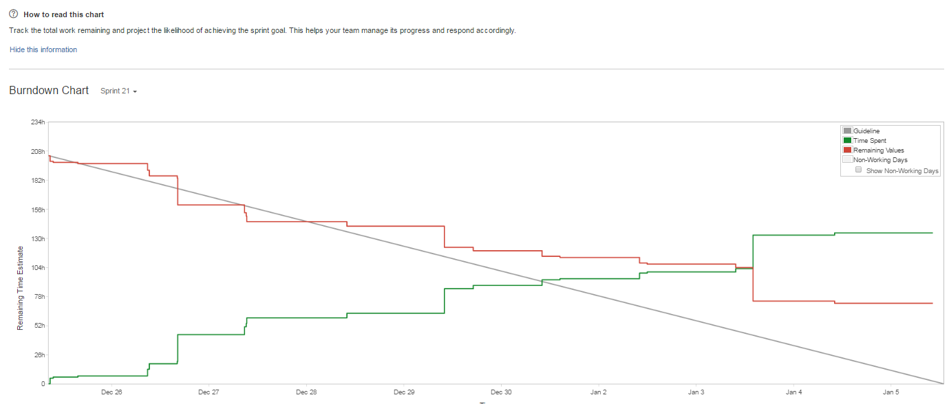
Burndown chart
Notes:
Burn Down chart is a primary scrum metric used to track implementation progress of agile project, a graphical representation of work left to do versus time.
The burn down chart is simple to explain:
X axis for days of the sprint
Y axis for effort (story points or hours or days depending on what you prefer)
Ideal line that visualize expected progress
Real line visualizing the current progress
Reading and understanding different burndown charts
http://www.scrumdesk.com/is-it-your-burn-down-chart/

Slide 46
Burndown chart
Single planning and tracking tool for the team
Risk mitigation by daily visibility
Calculated accordıng to remaınıng hours of the tasks
Notes:
Single planning and tracking tool for the team
The team comes up with a tasks breakdown, the team updates estimated effort, and the team also updates effort remaining. This empowers the team to own the plan. The entire team drives planning and tracking using the burn-down tool, which is the biggest advantage of using it.
Scope management: Tasks represent the overall scope of the sprint. Anything that is not part of the task list is out of scope for the sprint.
Schedule management: The team plans what it has to accomplish in a sprint and updates the task list. As it updates daily effort details, the team knows whether it is on track to meet the commitment or not.
Risk mitigation by daily visibility
Schedule overrun and cost overrun are two important metrics that get tracked in traditional project management. Mostly they're tracked on a weekly basis. The burn-down chart, on the other hand, provides daily feedback on effort and schedule, thereby mitigating the risks and raising alarms as soon as something goes wrong. For example, if actual progress line (the blue line) goes flat and hovers high above ideal line (the red line), the team knows it is in trouble. Mitigations can be planned right then, rather than waiting till the end. Communication tool for customer and other stakeholders
Burn-down charts are an effective communication tool for customer and stakeholders.
This can be printed and placed in an Agile room or shared with relevant stakeholders every day. This provides visibility of project progress on a daily basis. In the absence of an online tool, burn-down can be physically represented using a whiteboard/chart paper and placed in the team area.
Placeholder to track retrospective action items
It's a good practice to include retrospective action items from the previous sprint as "nonfunctional requirements" in the task breakdown for the current sprint. This way, the team keeps a focus on those action items, and they are also tracked as the sprint progresses.

Slide 47
Definition of Done
Definition of done is a simple list of activities , to be used to check ıf a story ıs done for the team
Unique per team
May change over time and per stories
Reviewed by team regularly in retrospectives and planning meetings
Checked by team before completion of an activity

Slide 48
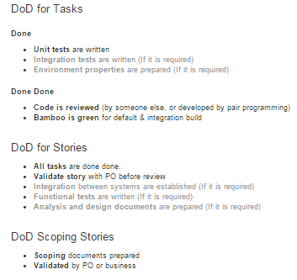
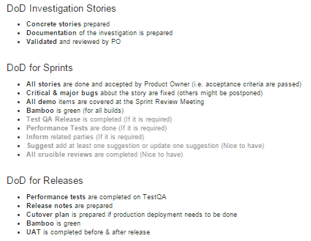
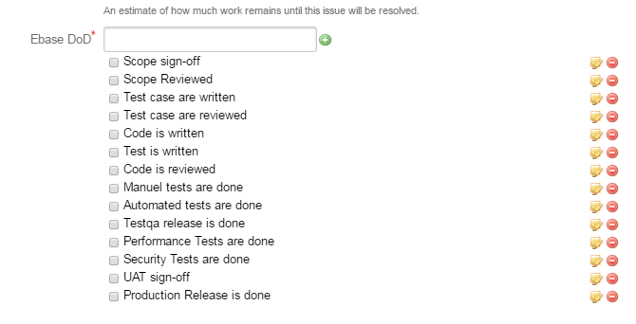
Definition of Done

Slide 49
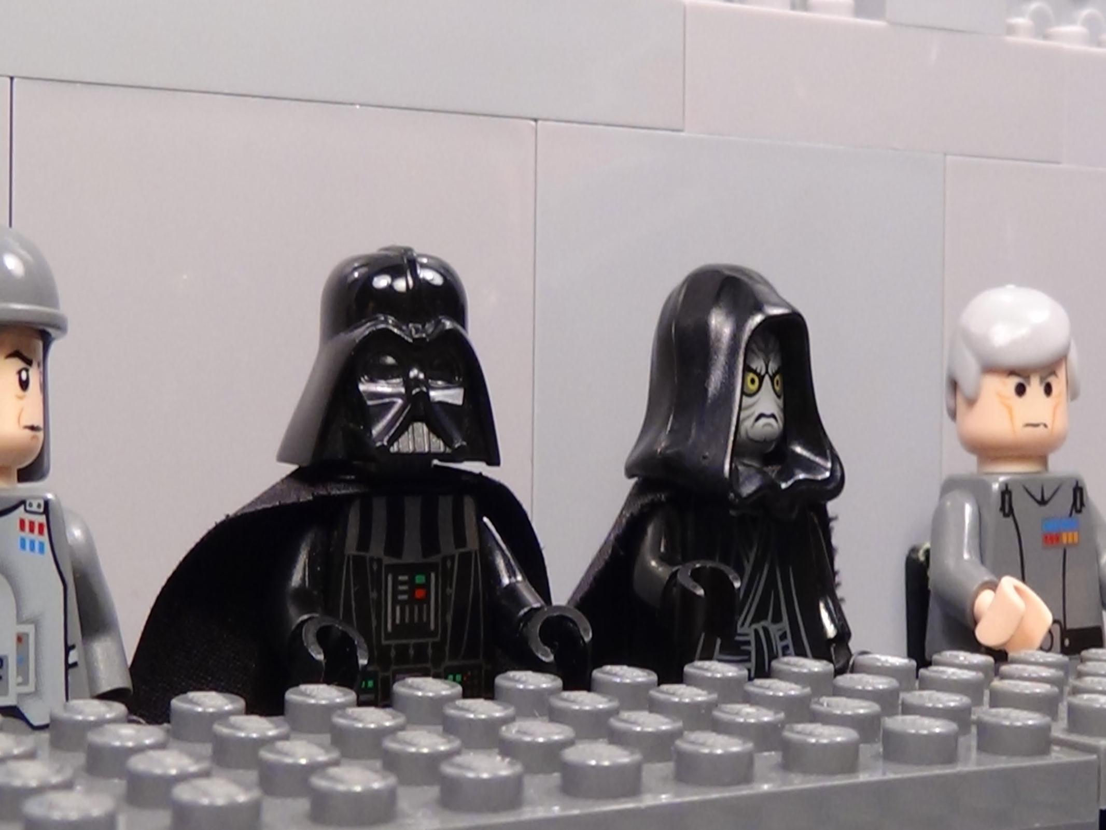
Sprint Review
Satisfy Product Owner
Get feedback on product
picture by oskay

Slide 50
Sprint Review
Informal, no slides, Show complete features
Preparation needed, demo to be displayed
Whole team participates
The world is invited
Accept or reject results
1-2 hours
per sprint/week (pre-review)
picture by oskay

Slide 51
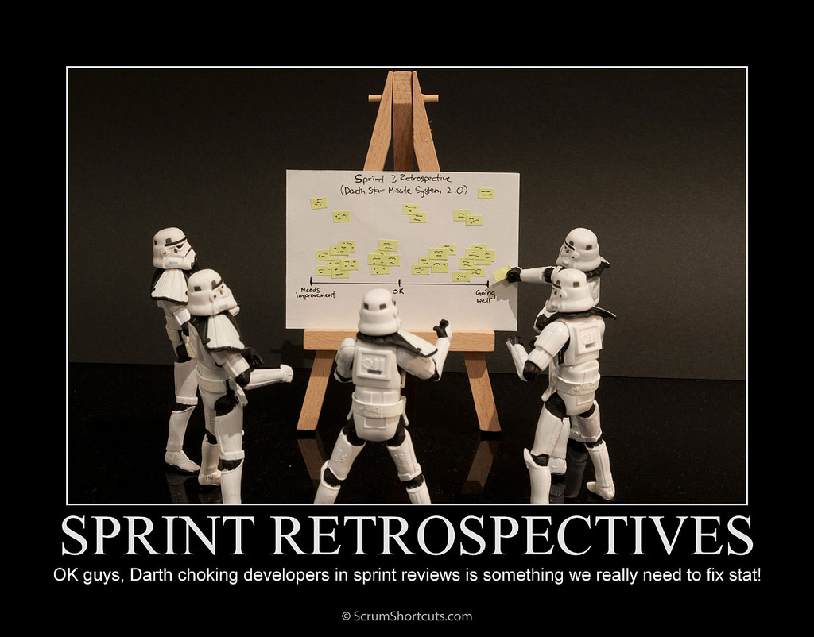
Evolve the process
picture by kevindooley

Slide 52
Sprint Retrospective
Reflect on process and product
Whole team participates
Done after every sprint
Actions to be noted & Followed up

Slide 53
Sprint Retrospective
Whole team gathers and discusses what they would like to
start doing
stop doing
continue doing

Slide 54
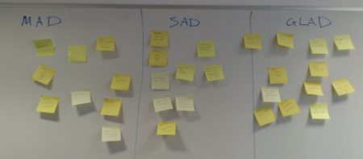

Sprint Retrospective sad mad glad
GLAD Pleased the team including
Things that went well
Things we learned
Novel ideas
Things to thank people for
SAD Disappointed the team specifically
Things to improve
Mad Frustrated the team
Including that didn’t go so well
Annoyed
Wasted time

Slide 55
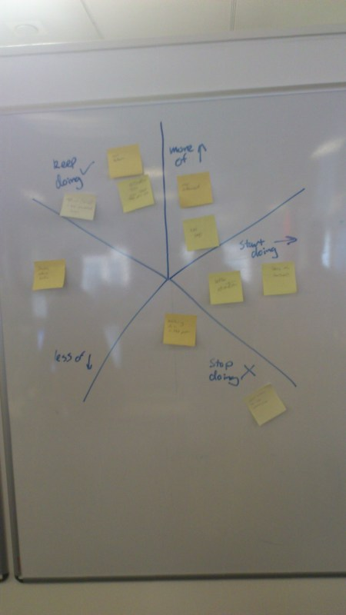
Sprint Retrospective The Wheel (the Starfish)
What can we start doing that will speed the team’s progress?
What can we stop doing that hinders the team’s progress?
What can we keep doing to do that is currently helping the team’s progress?
What is currently aiding the team’s progress and we can do more of?
What is currently impeding the team’s progress and we can do less of?

Slide 56
Sprint Retrospective more alternatives
Change the facilitator
Change the style (over a coffee, Lunch etc)
kudos to the team (Appreciate and thank to team members for the ways they have helped each other, give them small kudos in the form of chocolates, smiley badges, and so on)

Slide 57
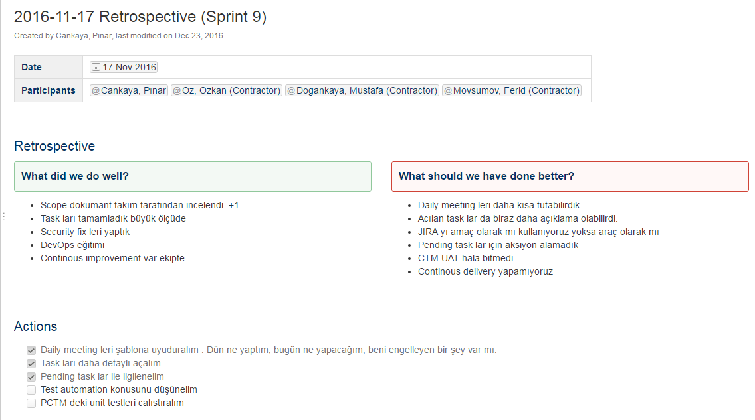
Sprint Retrospective radiator
Follow-up on action items that the team identifies in the retrospective use some electronic tool or a visual indicator
Notes:
Having some sort of visual indicator of the action items, along with the people responsible for them, always helps the team stay focused. Generally we tend to forget the action items that are derived from the retrospective. So before starting the retrospective, it's important to revisit the previous retrospective's action items and see how many of them are still pending.

Slide 58

Sprint termination
Only in extreme cases
sprint goal can not be meet due to changing business priorities
Work reverted to end of prior sprint
Raises visibility of problems

Slide 59
Testing in agile/scrum
Test as soon as possible
Involvement of PO/customer as soon as possible
Testing in development during the sprint, early uat
Demo of product in pre-review review meetings
UAT in Staging environment in the next sprint
Performance and security tests as soon as possible
More and more automated tests

Slide 60
Agile adoption-change mindset
Can scrum fail? NO!
Scrum is not a silver bullet ….it surfaces the existing problems
It does not fail, it is a simple framework but hard to implement
As
it is a completely new way of thinking and mind-set shifting

Slide 61
Why scrum implementation may fail?
Culture & MAnagement
Force commitments
Ask for not needed or invaluable status and measure
No tolerance for failures
Tendency to old norms
Exhausted team, no calm period, no place for innovation

Slide 62
Why scrum implementation may fail?
Bad scrum master
Driving the time and task allocation
Fails to make a prioritized impediment list
Become team administrator
Do not keep the team in “the zone”
No or bad retrospectives
Wrong definition of done
No velocity tracking

Slide 63
Why scrum implementation may fail?
Bad product owner
Constantly unavailable
Fail to get consensus
Does not have a vision, business plan and release roadmap
Poorly defined stories
On-going changes in sprint backlog

Slide 64
Why scrum implementation may fail?
Team
Not acting like a self managed team
Prima donna/dictator/hero within the team
Depend on external expertise
Personal goals rather than team goal
Tasks are assigned
Not helping or listening each other
Too much interruptions/ po-SM bypassed

Slide 65
agıle is all about
Constantly inspecting and improving
Learn and adapt
Improve value
Improve process
Continuous improvement
Improve communıcatıon
Improve code qualıty
Improve testıng qualıty
Reduce ımpedıments
Reduce lead tıme

Slide 66
Useful lınks
Agıle manıfesto
http://agilemanifesto.org/
7 of the top agıle project management software :
http://blog.capterra.com/agile-project-management-software/
Some gsı projects :
https://jira.sony-europe.com/jira/secure/RapidBoard.jspa?rapidView=61&view=planning&selectedIssue=OCTP-364
https://jira.sony-europe.com/jira/secure/RapidBoard.jspa?rapidView=60
Burndown chart:
http://www.scrumdesk.com/is-it-your-burn-down-chart/

Slide 67

Thank you

